Slide 1

Market Analysis
Nate Rodriguez

Slide 2
Analysis Goal and Action Steps
Goal: Identify the top 10 DMAs (markets) in an analytical and data driven way.
1. Preview each dataset. Begin thinking about how each one will be used in the analysis by taking note of column names.
2. Identify important datasets. If needed, change file type in order to analyze in Python (XLSX to CSV).
3. Perform necessary data cleaning. This includes changing data types, removing duplicates, dropping unnecessary variables, and renaming column names for effective analysis.
4. Merge datasets on common columns to obtain a dataset “market_data” that includes key characteristics for modeling and analysis. Export this dataset as a CSV in order to visualize in PowerBI.
5. Exploratory Data Analysis: Visualizations and numerical summaries of key market performance predictors.
6. Use aggregation to tabulate averages for each important market metric and upload that new data set “Market Metrics” into python notebook.
7. Utilize K-means clustering to group markets with ones that they are similar to using the new dataset. Identify the ideal number of clusters by using the elbow method.
8. Interpret the results of the clustering model by analyzing the variable means for each cluster. Compare clusters, and interpret what each cluster means in context.
9. Create an excel scorecard using “Market Metrics” dataset. Quantitatively rank each market and combine domain knowledge to finalize rankings.

Slide 3
Data Selection: Merging, Cleaning, Transformations
Identifying Key Datasets:
I decided that my analysis would be centered around 4 datasets: sales data-set, features, stores data-set with DMA, and the third sheet of PI-18803 DMA.
Final Dataset:
Store (int)
Date (date)
Weekly_Sales (float)
CPI (float)
Unemployment (float)
DMA (object)
Latitude (float)
Longitude (float)
Country (object)
Population 18+ (float)
Household Count (float)
Med HHld Income (float)
Merging in Python:
Sales, Features, and Stores datasets were merged in using the common column “Store”.
Once these were combined, I merged PI-18803 DMA dataset, which I will refer to as “DMA info”, on the common column, “DMA”.
To ensure merging would limit data loss, I cleaned each data set so that columns, entries, and objects were spelled the same across all data.
Other Cleaning in Python:
Removing non-target variables, changing data types to match its corresponding values.
Shape: (431781, 12)

Slide 4
Exploratory Data Analysis
Computing averages for key market performance metrics.
These aggregated summaries are helpful in comparing metrics at a DMA level and will later be used to create the Market Scorecard within excel.

Slide 5
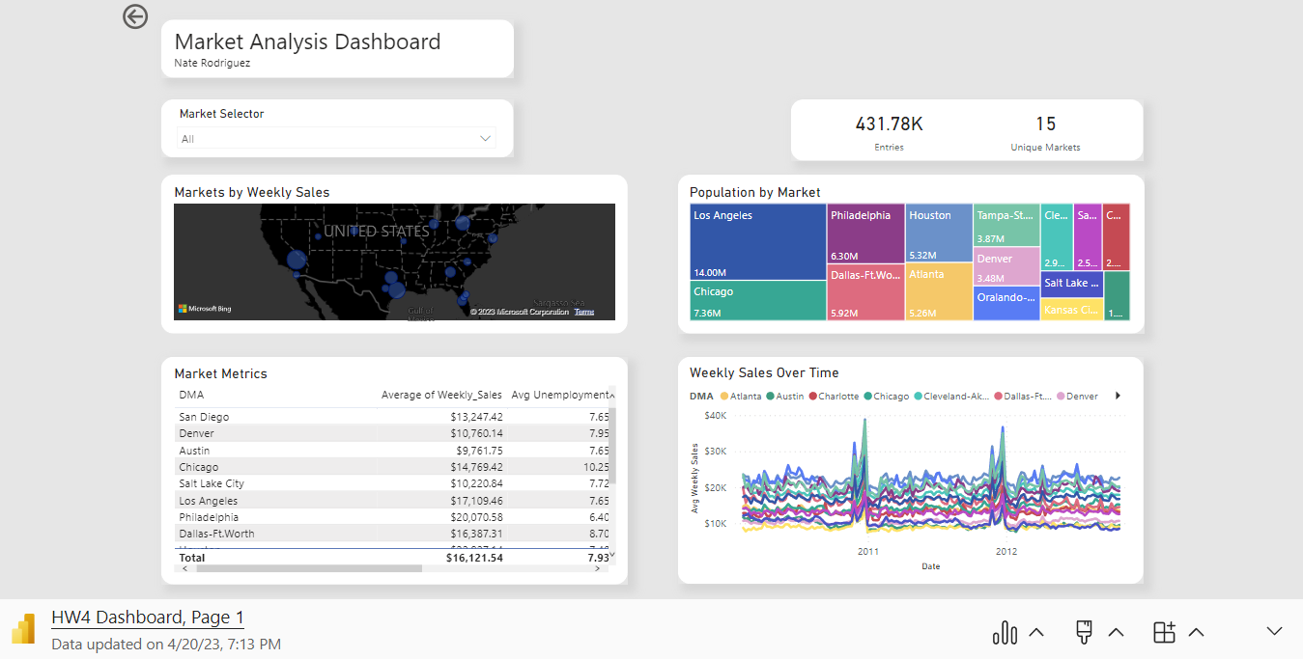
EDA Continued (Power Bi)
In order to better understand my data, I created a dashboard within Power BI. By doing so, I was able visualize my data in an interactive way and use the dashboard as a reference to my future analysis.

Slide 6
First Modeling Method: Clustering
To identify trends within the data set, I ran a K-Means clustering model on three of the more important Market Metrics: Population, Median Income, and Weekly Sales.
Cluster 1:
Cluster 2:
Cluster 3:
Means of the Cluster:
Weekly Sales 17516.15
Unemployment 8.04
CPI 158.82
Median Income 66564.67
Population 7361803
Means of the Cluster:
Weekly Sales 18759.16
Unemployment 7.22
CPI 178.45
Median Income 53693.88
Population 3115359
Means of the Cluster:
Weekly Sales 10618.15
Unemployment 8.16
CPI 194.75
Median Income 69942.40
Population 2400244
These cluster averages help identify trends for each cluster. Cluster 1 is indicative of DMA’s that are large, populous-areas with middle-of-the-road sales and income. Cluster 2 has lower income DMA’s that still experience high weekly sales and an average population. Cluster 3 has less populous DMA’s with higher incomes, but low weekly sales. From this analysis, I would identify the markets in clusters 1 and 2 to be the most attractive. I will compare these results with later analysis to finalize my decision.

Slide 7
Second Modeling Method: Market Scorecard
Utilizing the aggregated summary table that I created before, I aimed to rank each market by creating a scorecard. This scorecard has 5 variables that describe 15 markets. Each market is ranked 1-15 (15 being the best and 1 being the worst) for each variable. This rank is then multiplied by a weight, or multiplier, that gives each market a weighted score for each variable. The weighted scores for each market will be summed up to determine a final weighted score. This final number will tell us where a market ranks in attractiveness compared to others. Full tabulation of the scorecard will be included in the appendix.
Variables Ranked by
Importance:
Weekly Sales
Median Income
Population
Unemployment
CPI
Weights
0.3333
0.2667
0.2
0.1333
0.06
Top 10 Markets According to Scorecard:
Philadelphia
Houston
Los Angeles
Chicago
Dallas-Ft. Worth
San Diego
Orlando- Daytona Beach-Melbourne FL
Denver
Atlanta
Tampa St. Pete
Calculation of Weights:
Rank of Metric / Number of Markets

Slide 8
Comparing Modeling Methods
The results of both models will be used in deciding the top ten markets to release my home goods and grocery store. Let’s see how the clustering model compared with the results of the scorecard.
Top 10 Markets According to Scorecard:
Philadelphia Cluster 1
Houston Cluster 1
Los Angeles Cluster 1
Chicago Cluster 1
Dallas-Ft. Worth Cluster 1
San Diego Cluster 3
Orlando- Daytona Beach-Melbourne FL Cluster 2
Denver Cluster 3
Atlanta Cluster 1
Tampa St. Pete Cluster 2
As you can see on the left, 8 of the 10 markets selected by the scorecard were included in Clusters 1 and 2; the previously determined attractive clusters.
This result gives me confidence in these 8 markets going into the final decision.

Slide 9
Other Significant Factors: Outside Research
The dataset carries significant market metrics such as sales, population, and income, but there are other factors that may make a market attractive. One factor that was not included in my modeling was market competitiveness. A highly competitive market with preexisting substitutes makes for a difficult launch. In order to analyze a markets competitiveness, I can look at the number of households in each market and divide that by the number of stores to get a ratio of households per store.
To the left you can see each markets “Households Per Store”, which I am using to evaluate competitiveness.
As you can see, San Diego and Denver, the two markets that were not identified as attractive in my clustering model but were in my scorecard model, show high competitiveness. This, in congruence with the scorecard model may influence where they fall in the rankings.
Chicago appears to be a uncompetitive market, and due to outside research, I learned that Walmart has permanently closed 4 of its Chicago locations (Gallardo & Wade, 2023). This may make it a great time for a new replacement store to take even more of that local market share.

Slide 10
Ten Most Attractive Markets (1-5)
Here is my list of the top ten markets and justification of why they belong in this list. Relative positions in this list are determined thanks to the scorecard model, competitive analysis, and outside research.
Philadelphia: Ranked first in my scorecard model, Philadelphia is the most attractive market due to its relatively high median household income and low unemployment rate, which suggests a strong local economy with a potentially large customer base. It also has the 3rd highest population. In addition to this, Philadelphia also is ranked as the 2nd most uncompetitive market, making this is great location to launch a store.
Houston: Ranked number 2 by my scorecard model and identified in cluster 1, Houston is the 2nd most attractive market due to its large population, high median household income, and high average weekly sales. Additionally, the unemployment rate is relatively low, which suggests a strong local economy with a large potential customer base for a home/grocery store.
Chicago: Although Chicago was ranked fourth by my scorecard model, I chose to put Chicago at third due to its ability to foster a high earning, low competition store. Chicago’s relatively high median income and large population make it a great place to earn market share and establish a name in the area.
Los Angeles: Los Angeles has a high median household income, but it also has a relatively high unemployment rate and moderate average weekly sales figure. However, its large population size and relatively high CPI may still make it an attractive market for launching a grocery store. A reason why Los Angeles isn’t higher on this list is because there are already 7 competitor stores in the area which could negatively effect brand our recognition.
Dallas Ft. Worth: Dallas-Ft. Worth has a relatively high median household income, a moderate average weekly sales figure, and a large population, but its unemployment rate is higher than other markets on the list, which slightly lowers its overall attractiveness.

Slide 11
Ten Most Attractive Markets (5-10)
Here is my list of the top ten markets and justification of why they belong in this list. Relative positions in this list are determined thanks to the scorecard model, competitive analysis, and outside research.
Orlando-Daytona Beach-Melbourne: This market has the second highest weekly sales, and a relatively low unemployment rate, which suggests a potentially strong consumer market. In addition to this, it appears to be an untapped market with it being the least competitive market.
Tampa St. Pete: Tampa-St. Pete has a slightly lower average weekly sales figure than Orlando-Daytona Beach-Melbourne, but it has a higher median household income and a moderate unemployment rate, which suggests a relatively strong potential customer base. It appears higher on this list than the scorecard due it its potential as a untapped market.
San Diego: San Diego’s ranking comes mostly from its place as the highest median household income. Its average weekly sales figure, moderate unemployment rate, and low population hinders its ability to be a more attractive market.
Atlanta: Atlanta has a moderate median household income and a moderate average weekly sales figure, but its relatively low unemployment rate may make it an attractive market. However, its lower CPI and population size slightly lower its overall attractiveness.
Denver: Denver has a high median household income and a relatively high unemployment rate, but its average weekly sales figure and CPI are both moderate. Its lower population size may also slightly lower its overall attractiveness compared to other markets on the list.

Slide 12
Limitations, Assumptions
Although I consider my analysis to be in depth, there are some limitations that may hinder its accuracy. For the entirety of my analysis, I was operating under my assumption that weekly sales, median household income, population, unemployment, and cpi (in that order) were the most important indicators of an attractive market from the given data. Although I am confident in my decision, I understand that there are other factors that effect a market attractiveness.
A second limitation is that this analysis was done with data collected in 2021. A market’s attractiveness can significantly change YoY, especially as environmental factors can affect inflation and unemployment.
A third assumption for this analysis is that the store I am launching would be able to operate in a similar manner to Walmart, as this analysis was conducted using Walmart data.

Slide 13
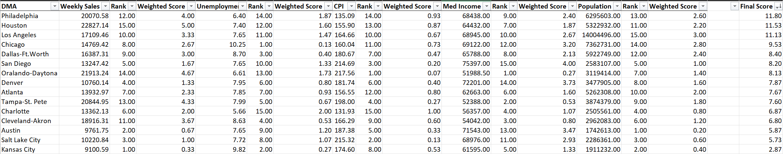
Appendix
Market Scorecard

Slide 14
References and Other Links
“Walmart Closes 4 Chicago Locations Permanently, Leaving Residents with Fewer Shopping Options.” ABC7 Chicago, 17 Apr. 2023, https://abc7chicago.com/walmart-closed-leaving-chicago-pharmacy-closing/13136460/.
GitHub Link: https://github.com/Nate-Rodriguez/MarketAnalysis

